Slide 1


Naan Mudhalvan
Voting web application using Django framework

Slide 2
Voting System Project Using Django Framework
Project Title: Voting web application using Django framework
Type of Application (Category): Web application.
Introduction:
We will create a pollster (voting system) web application using Django. This application will conduct a series of questions along with many choices. A user will be allowed to give voting for that question by selecting a choice. Based on the answer the total votes will be calculated and it will be displayed to the user. Users can also check the result of the total votes for specific questions on the website directly. We will also build the admin part of this project. Admin user will be allowed to add questions and manage questions in the application.

Slide 3
Objectives:
The project aims to achieve several objectives in developing a pollster web application using Django. Firstly, it strives to create an intuitive and seamless user experience, enabling users to easily navigate through a series of questions and provide their votes by selecting from available choices. Secondly, the system will ensure accurate aggregation and presentation of voting results, providing users with transparent insights into the total votes for each question. This objective involves implementing robust algorithms to calculate and update the vote counts in real-time. Moreover, the project seeks to enhance user engagement by allowing users to directly access the results of specific questions on the website, fostering transparency and participation. Additionally, the creation of an administrative panel will empower authorized personnel to efficiently manage the content of the application, including adding new questions and overseeing existing ones. Overall, the objectives encompass user-centric design, accurate data processing, transparent result dissemination, and streamlined administrative control, culminating in a comprehensive and functional pollster web application.

Slide 4
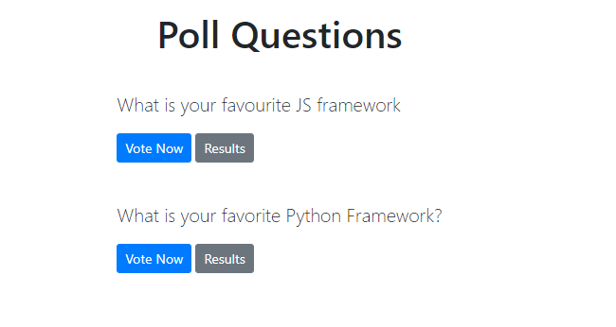
Pre-requisite:
Knowledge of Python and basics of Django Framework. Python should be installed in the system. Visual studio code or any code editor to work on the application.
Technologies used in the project:
Django framework and SQLite database which comes by default with Django.

Slide 5
Implementation of the Project
Creating Project:
Step-1:
Create an empty folder Pollster_project in your directory.
Step-2:
Now switch to your folder and create a virtual environment in this folder using the following command.
Pip install pipenv
pipenv shell

Slide 6
Step-3:
A Pipfile will be created in your folder from the above step. Now install Django in your folder using the following command.
Step-4:
Now we need to establish the Django project. Run the following command in your folder and initiate a Django project.
A New Folder with name pollster will be created. Switch to the pollster folder using the following command.
pipenv install Django
django-admin startproject pollster
cd pollster

Slide 7
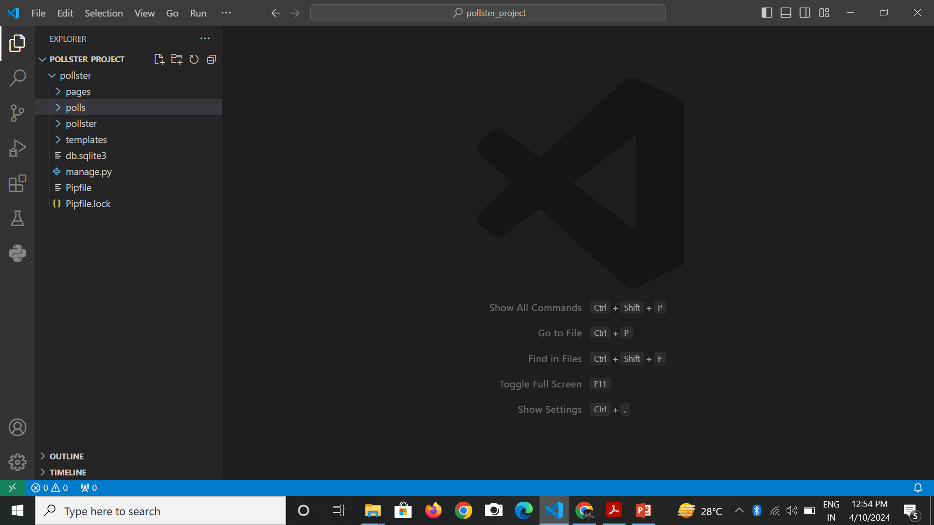
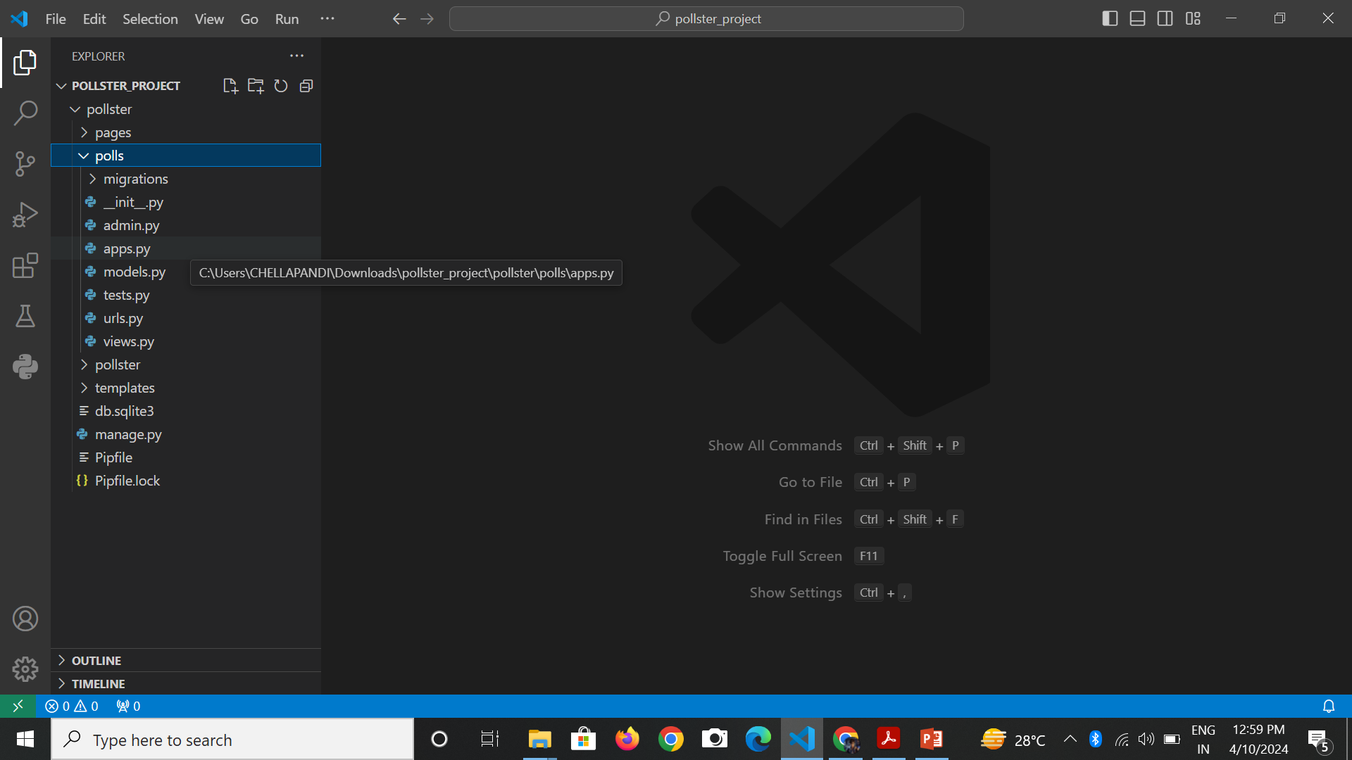
The folder structure will look something like this.
Here you can start the server using the following command and check if the application running or not using your http://127.0.0.1:8000/ in your browser.
python manage.py runserver
Step-5:
Create an app ‘polls‘ using the following command
python manage.py startapp polls

Slide 8
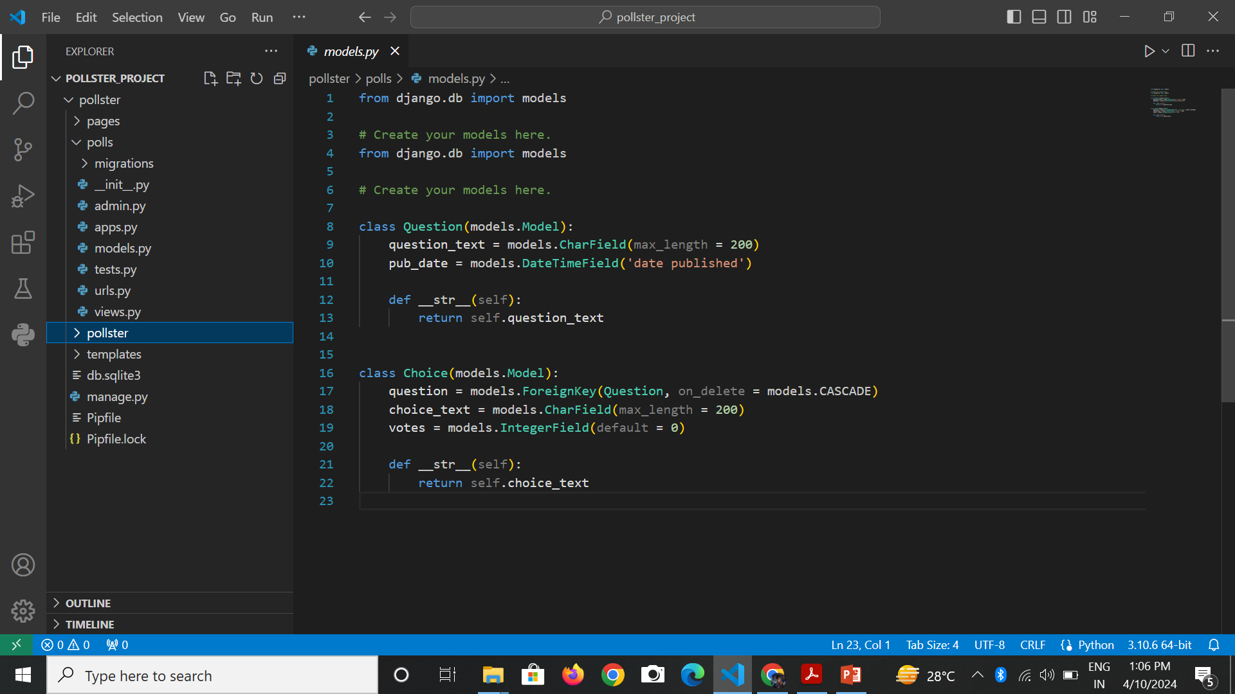
Create Models
Step-1:
In your models.py file write the code given below to create two tables in your database. One is ‘Question‘ and the other one is ‘Choice‘. ‘Question’ will have two fields of ‘question_text’ and a ‘pub_date’. Choice has three fields: ‘question’, ‘choice_text’, and ‘votes’. Each Choice is associated with a Question

Slide 9
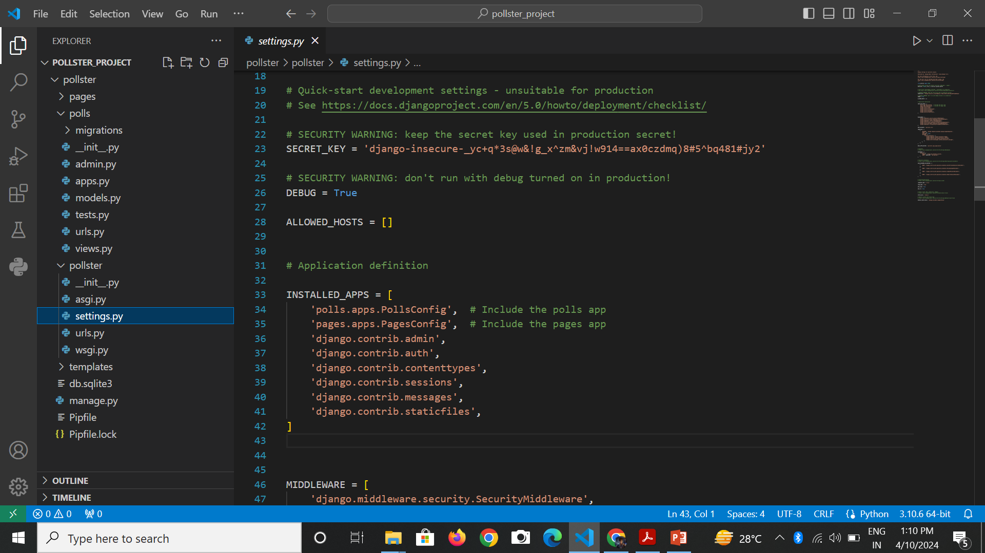
Step-2:
Go to the settings.py file and in the list, INSTALLED_APPS write down the code below to include the app in our project. This will refer to the polls -> apps.py -> PollsConfig class.

Slide 10
Step-3:
We have made changes in our database and created some tables but in order to reflect these changes we need to create migration here and then Django application will stores changes to our models. Run the following command given below to create migrations.
python manage.py makemigrations polls
Inside polls->migrations a file 0001_initial.py will be created where you can find the database tables which we have created in our models.py file. Now to insert all the tables in our database run the command given below…
python manage.py migrate

Slide 11
Create an Admin User
Step-1:
Run the command given below to create a user who can login to the admin site.
It will prompt username which we need to enter.
Now it will prompt an email address which again we need to enter here.
python manage.py createsuperuser
Username: abc123
Email address: xyz@example.com

Slide 12
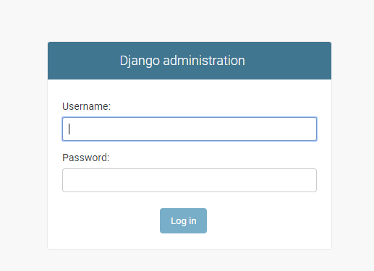
The final step is to enter the password. We need to enter the password twice, the second time as a confirmation of the first.
Password: ******
Password (again): ******
Superuser created successfully.
Now we can run the server using the same command python manage.py runserver and we can check our admin panel browsing the URL http://127.0.0.1:8000/admin .

Slide 13
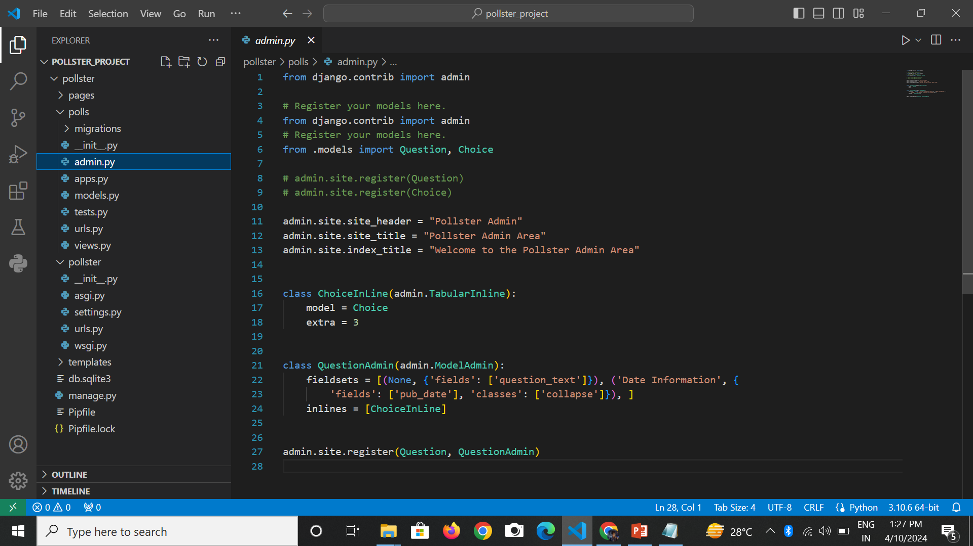
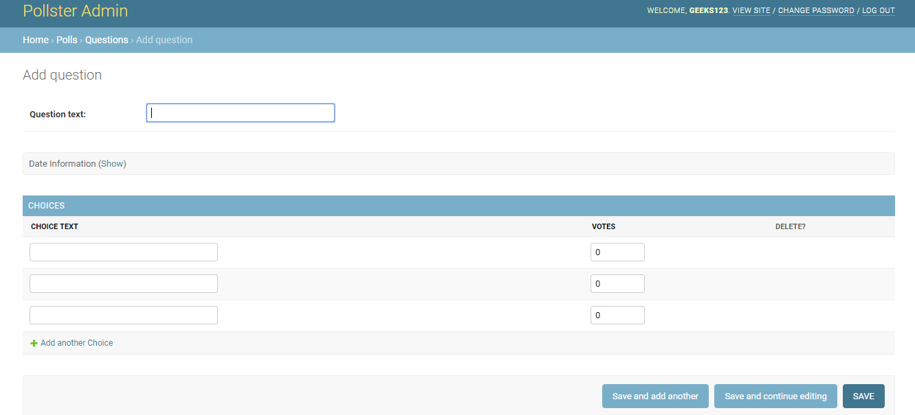
Step-2:
In the admin.py file we will write the code given below to map each question with choices to select. Also, we will write the code to change the site header, site title, and index_title. Once this is done we can add questions and choices for the question from the admin panel.

Slide 14
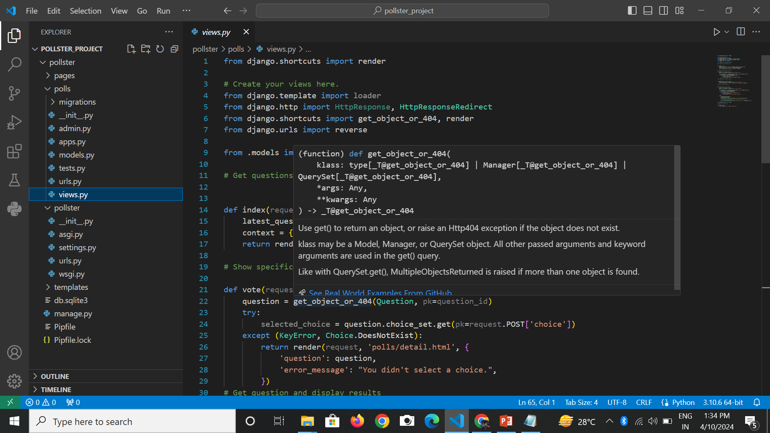
Create Views
Now we will create the view of our application that will fetch the data from our database and will render the data in the ‘template‘ (we will create ‘template’ folder and the files inside this folder in the next section) of our application to display it to the user.
Step-1: Open views.py file and write down the code given below

Slide 15
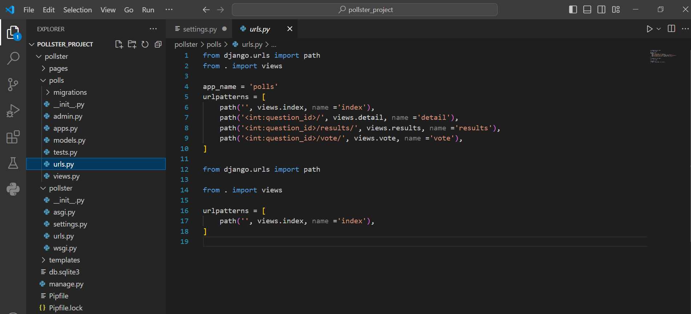
Step-2: Create a file urls.py inside the pollster->polls folder to define the routing for all the methods we have implemented in views.py file (don’t get confused with the file inside the pollster->pollster->urls.py file). Below is the code of urls.py file…

Slide 16
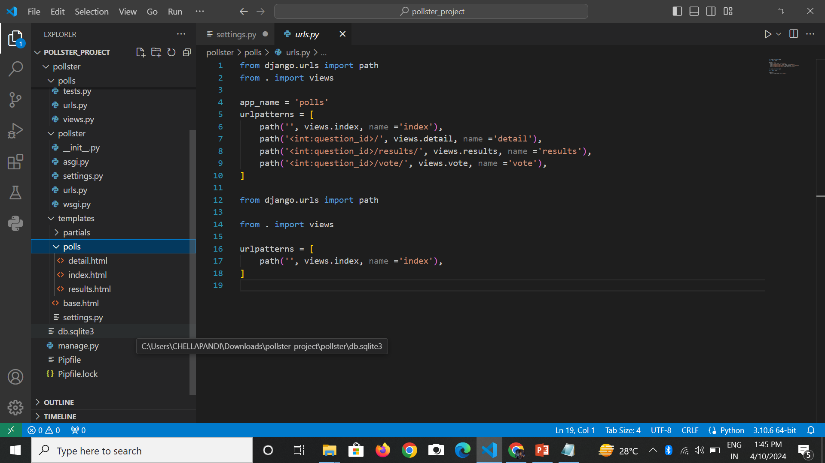
Create Templates
Step-1: Follow the steps given below to create the front layout of the page.
Create a folder ‘templates‘ in top-level pollster folder (alongside of polls and pollster) i.e. pollster-> templates
Create ‘base.html‘ file inside the template folder. We will define the head, body and navigation bar of our application in this file.
In the ‘templates’ folder create another folder ‘polls‘. In ‘polls’ folder create three files ‘index.html‘, ‘results.html‘ and ‘detail.html‘.
The folder structure will look like the image given below

Slide 17
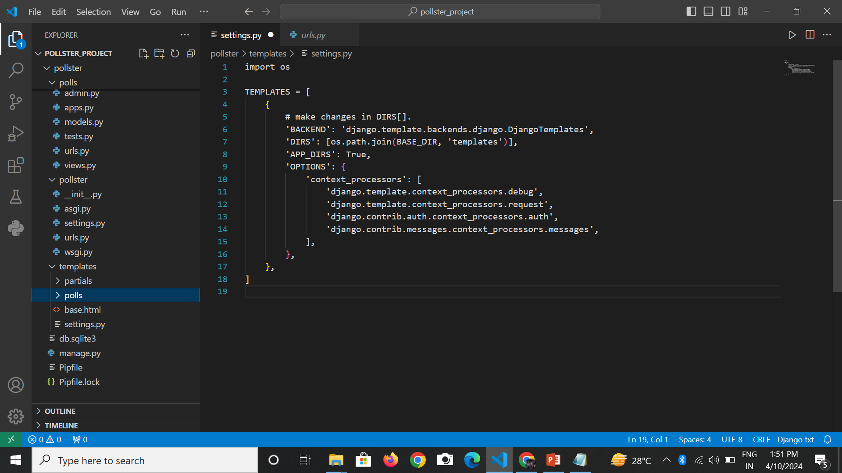
Step-2:
By default Django will search the ‘template’ inside the ‘polls’ app but we have created a global ‘template’ folder which is outside the polls app. So in order to make it work, we need to define the ‘template’ folder path inside the settings.py file. Open settings.py file and add the code given below in the list ‘TEMPLATES’. In order to make the given code work add “import os” in settings.py.

Slide 18
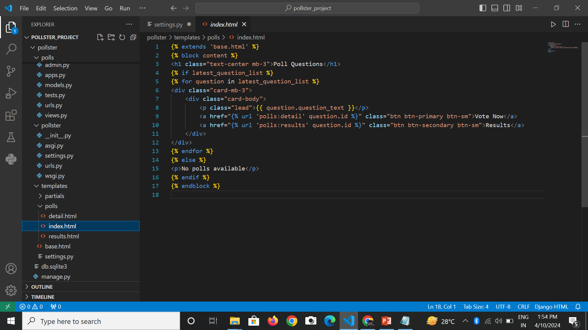
Step-3:
Open index.html file and write the code given below. This file will display the list of questions which are stored in our database. Also, two buttons will be displayed to the user. One for the voting (we will create a detail.html file for voting) and the other one is to check the results (we will create results.html file for results).

Slide 19
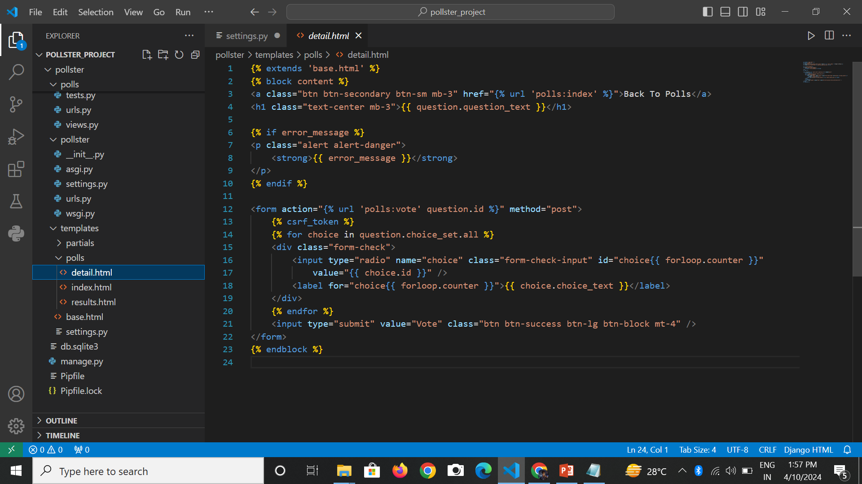
Step-4:
Open detail.html file and write the code given below. This file will be responsible for voting on specific questions. Whatever question a user will select for voting from the list of the question (index.html file), that specific question and the choices for the question will be displayed on this page. A user will be allowed to select one choice and give voting by clicking on the vote button.

Slide 20
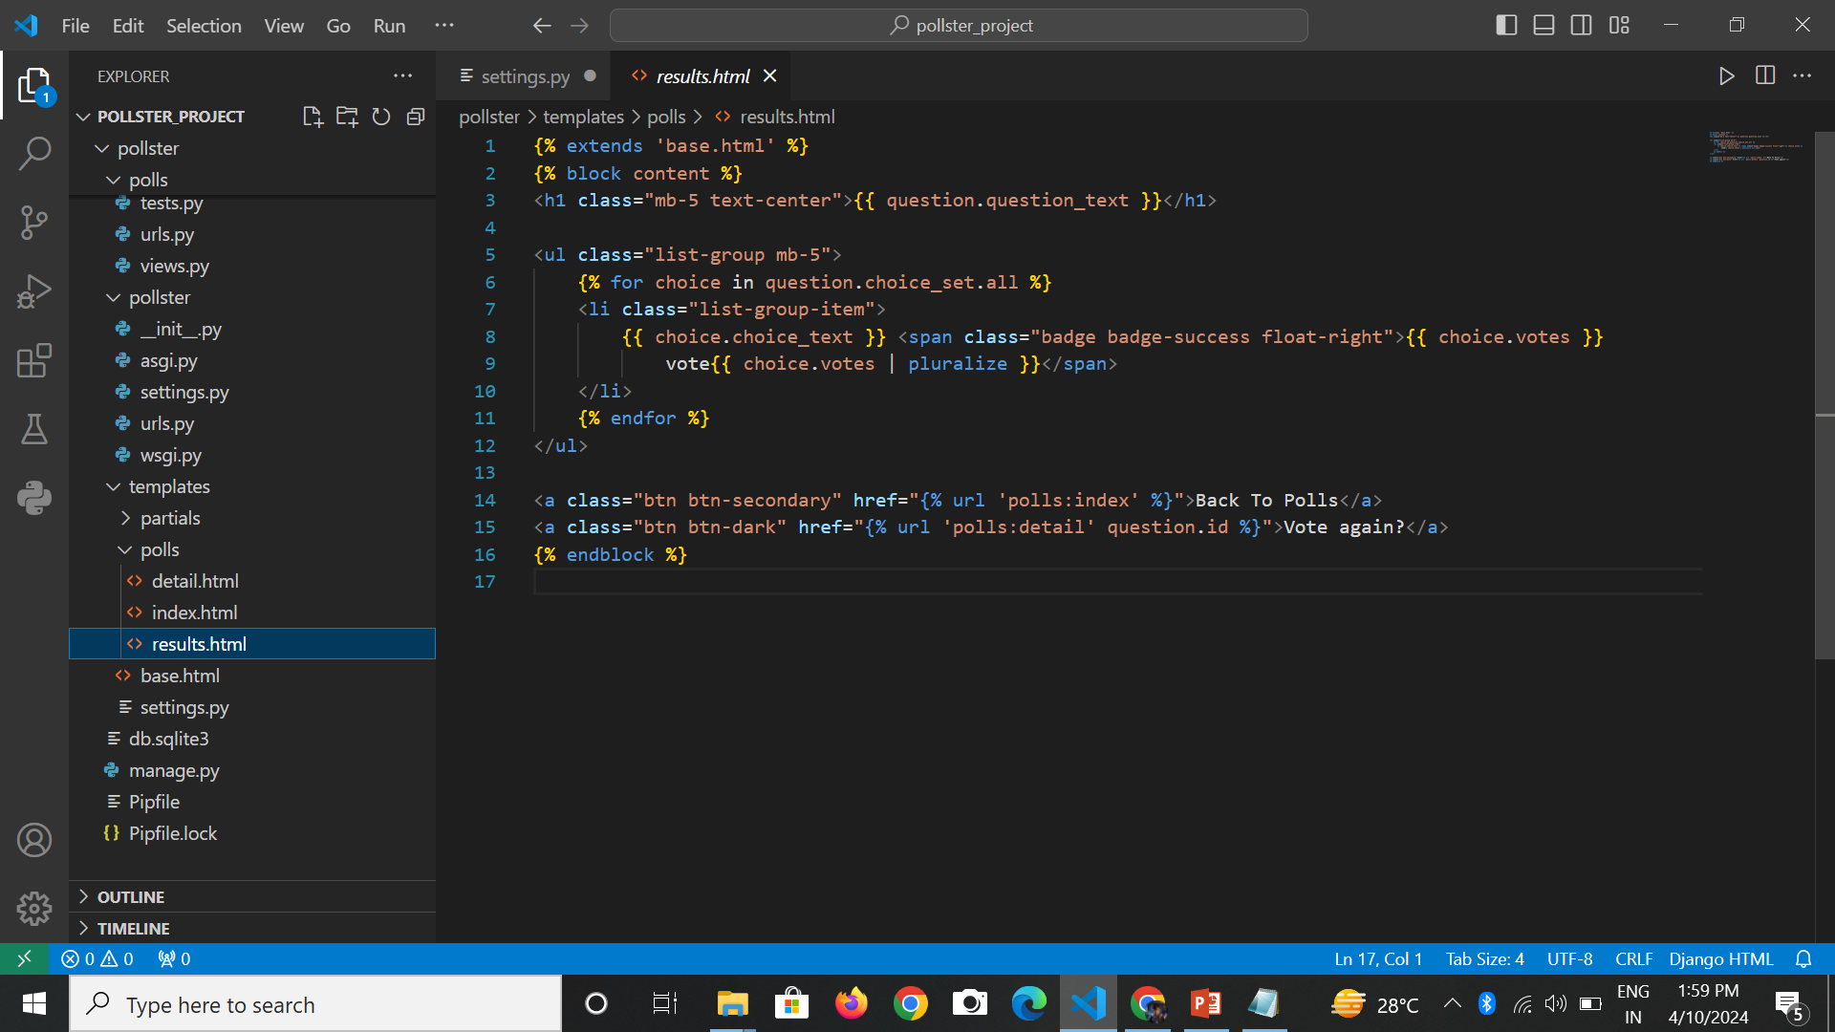
Step-5:
Open results.html file and write the code given below. This file will display the result of total votes on a specific question whatever question the user will select (from the index.html file) to check the result.

Slide 21
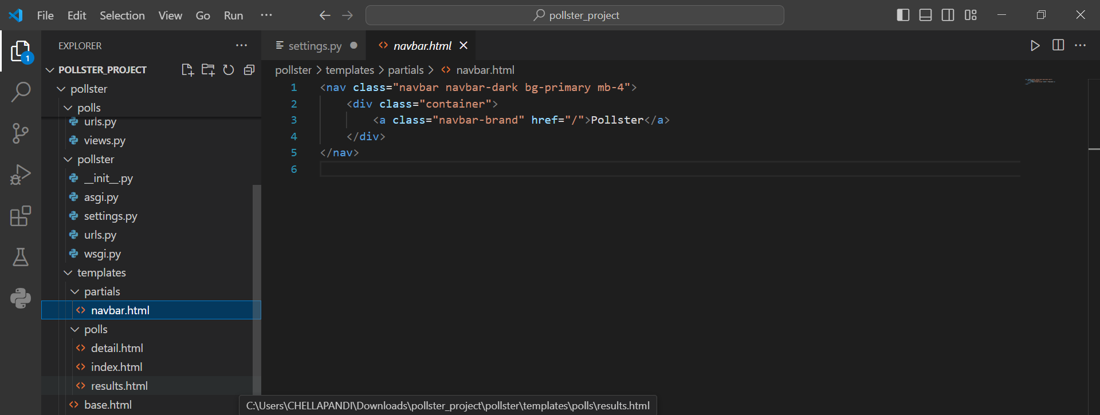
Step-6:
Let’s create the navigation bar for our application. Create a folder ‘partials‘ inside the folder ‘templates’ and then create a file ‘_navbar.html‘ inside the ‘partial’ folder. File structure will be templates->partials->_navbar.html. Write the code given below in this file.

Slide 22
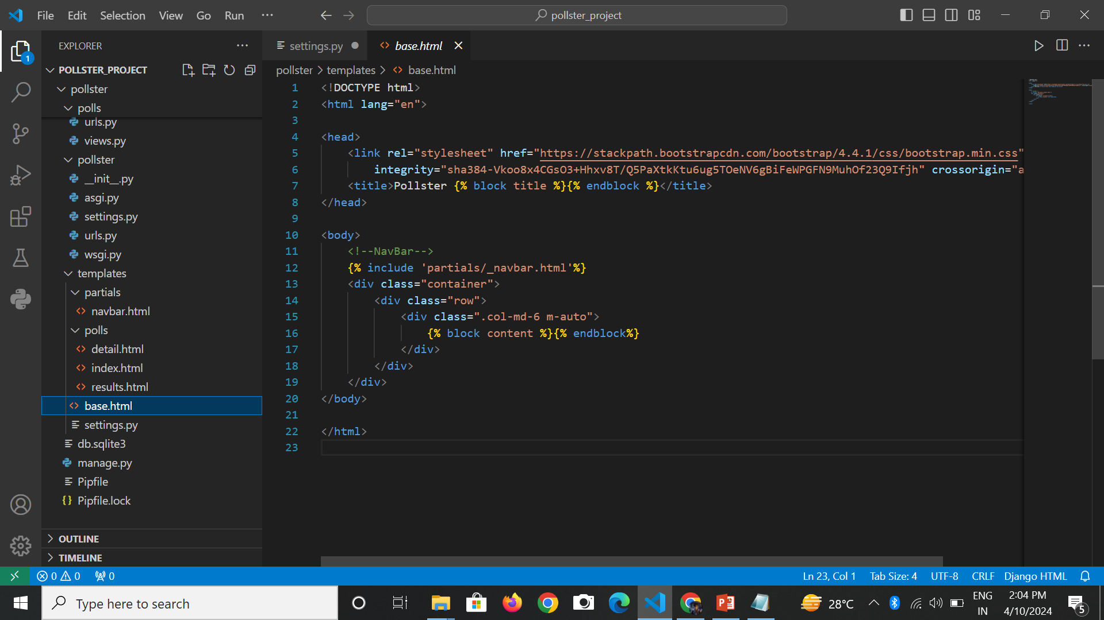
Step-7:
We haven’t included the head and body tag in every single HTML file we have created till now. We can write these codes in just one single file base.html and we can give the layout to our page. We will also bring our navigation bar(_navbar.html file) on this page. So open base.html file inside the ‘template’ folder and write down the code given below.

Slide 23
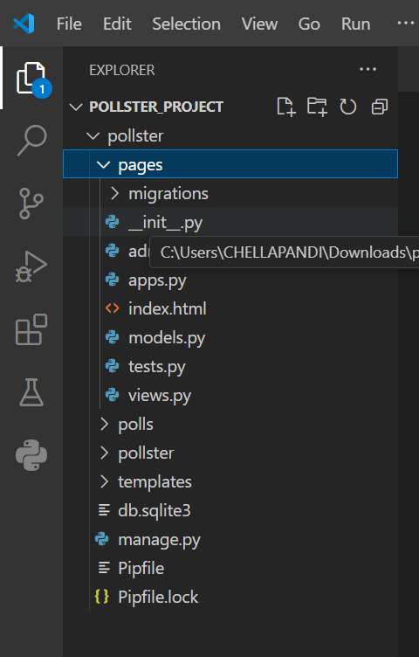
Create Landing Page
The URL http://127.0.0.1:8000/ should display a landing page for our web application. So to create a landing page we will follow the step given below.
Step-1 :
Switch to the top-level pollster folder and run the command given below to create an app ‘pages‘.
python manage.py startapp pages
Below is the folder structure once the ‘pages’ app will be created.

Slide 24
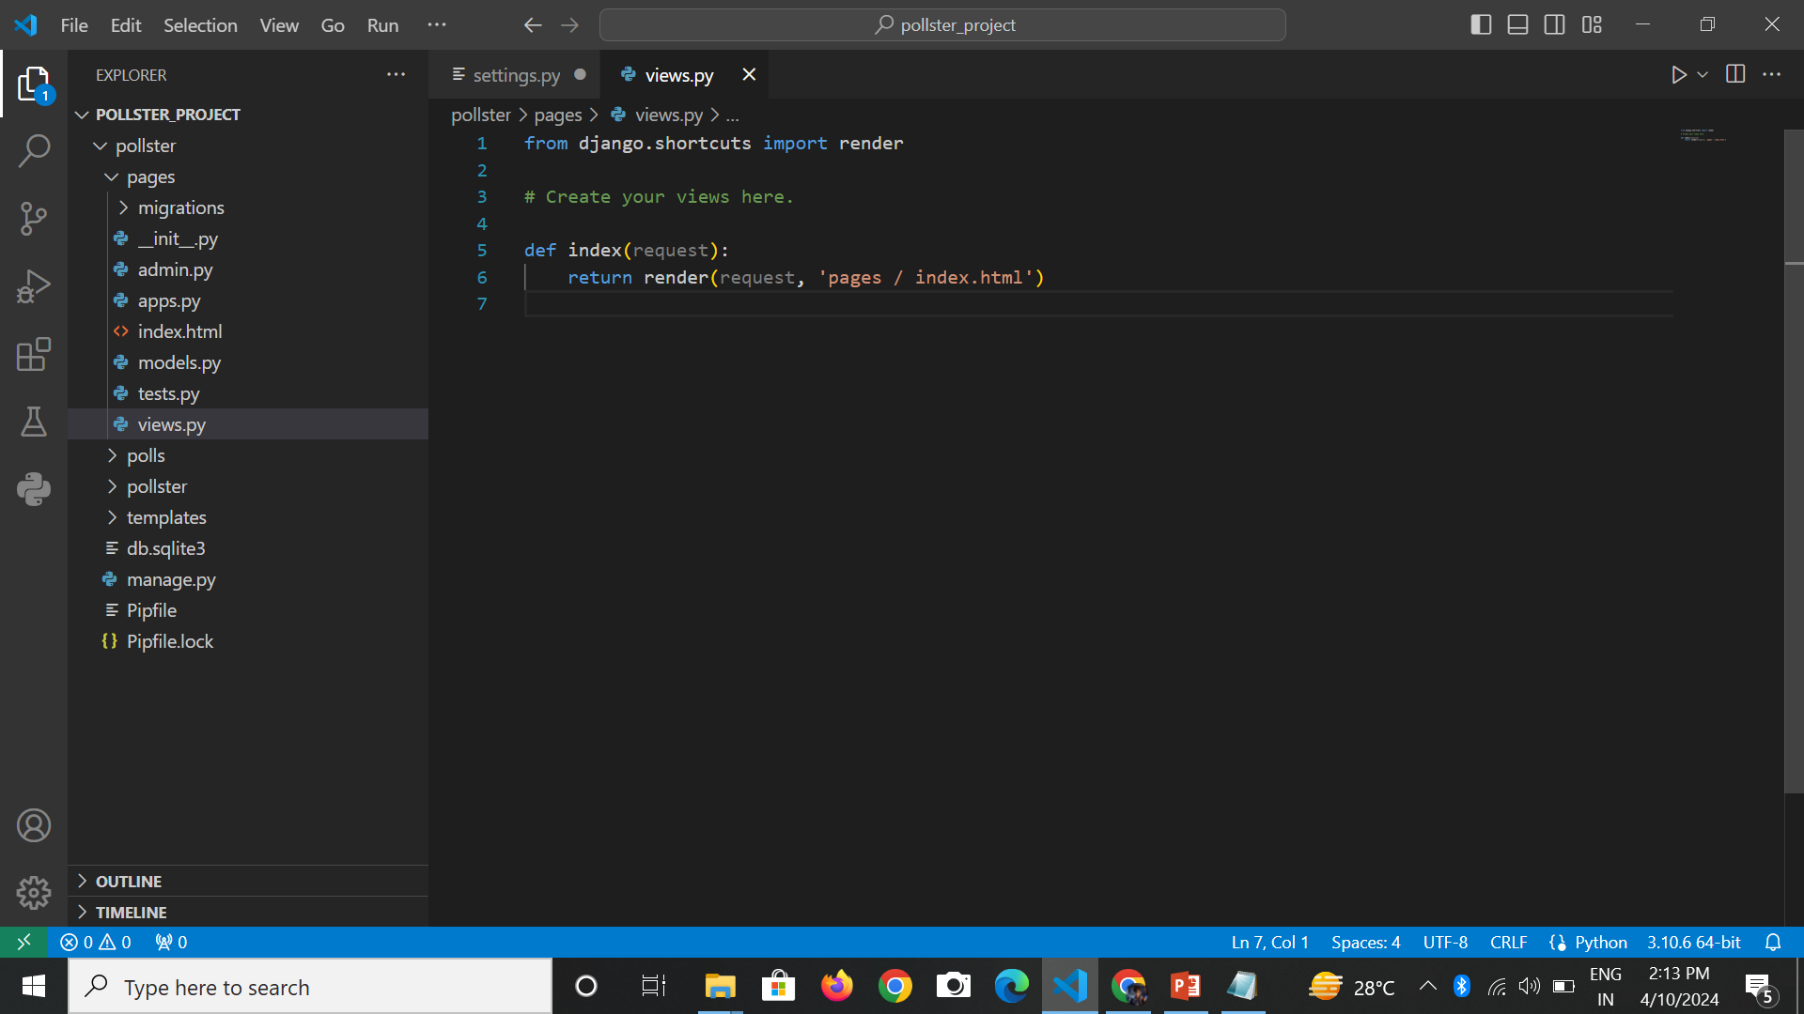
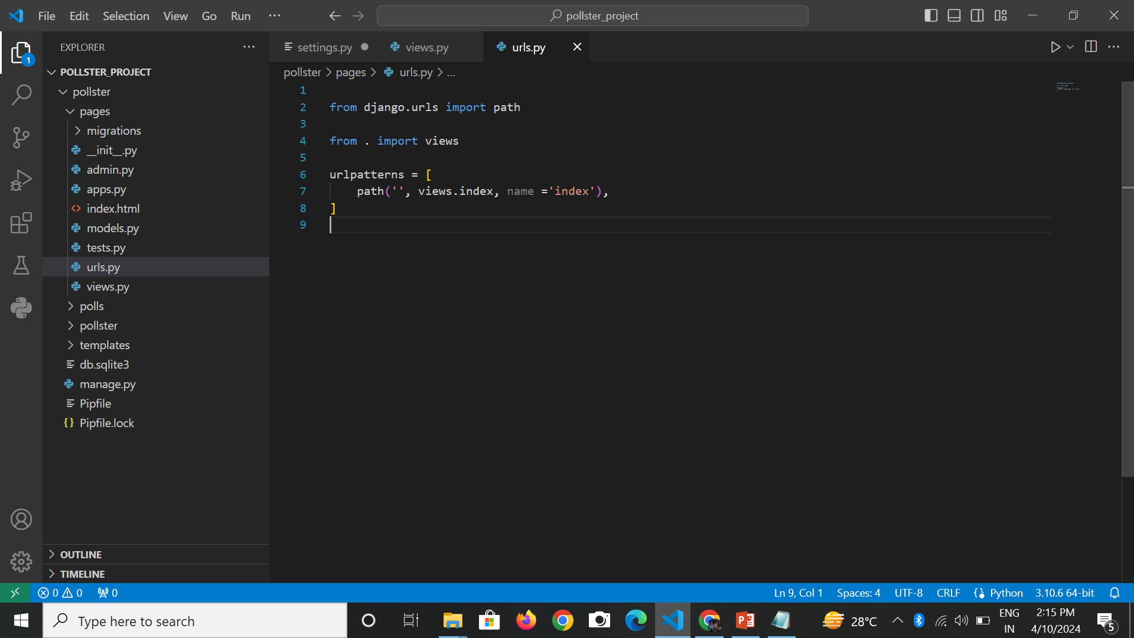
Step-2:
Open ‘views.py‘ inside ‘pages’ folder i.e. pages->views.py. Write down the code given below to visit on landing page.
Step-3:
Create urls.py file inside the ‘pages’ folder i.e. pages->urls.py. Write the code given below to define the routing of pages->index.html file (check step-1).

Slide 25
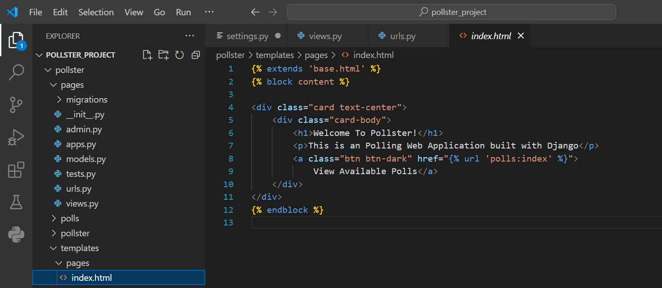
Step-4:
Create a folder ‘pages‘ inside ‘template’ folder. Now inside ‘pages’ folder create a file index.html. Write down the code given below to display the landing page to the users.

Slide 26
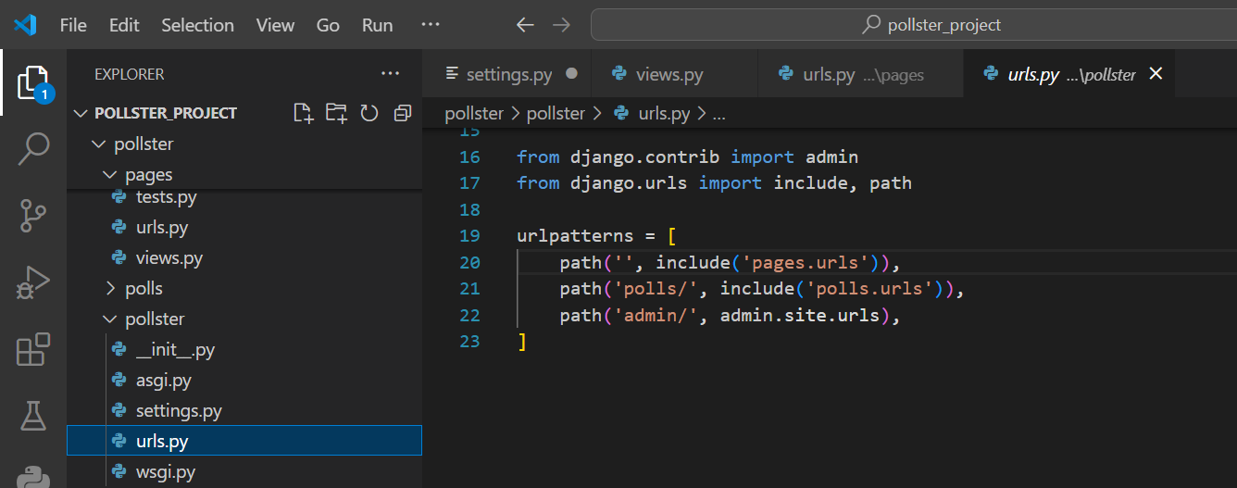
Create routing inside the main urls.py file of the application
We have created two apps in our application ‘polls‘ and ‘pages‘. We need to define the routing of these two apps inside the main urls.py file which is pollster->pollster->urls.py file. So open the main urls.py file inside the pollster folder and write down the code given below to define the routing of these two apps(‘polls’ and ‘pages’).

Slide 27
Testing of the Application
Admin Frontend:
Step-1:
Run the server using the command python manage.py runserver and browse the URL http://127.0.0.1:8000/admin/. Now enter the username and password to login into the system.
abcdef123
********

Slide 28
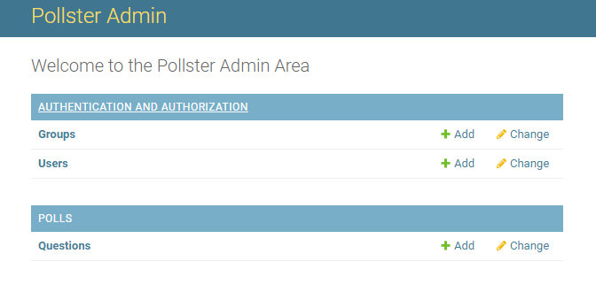
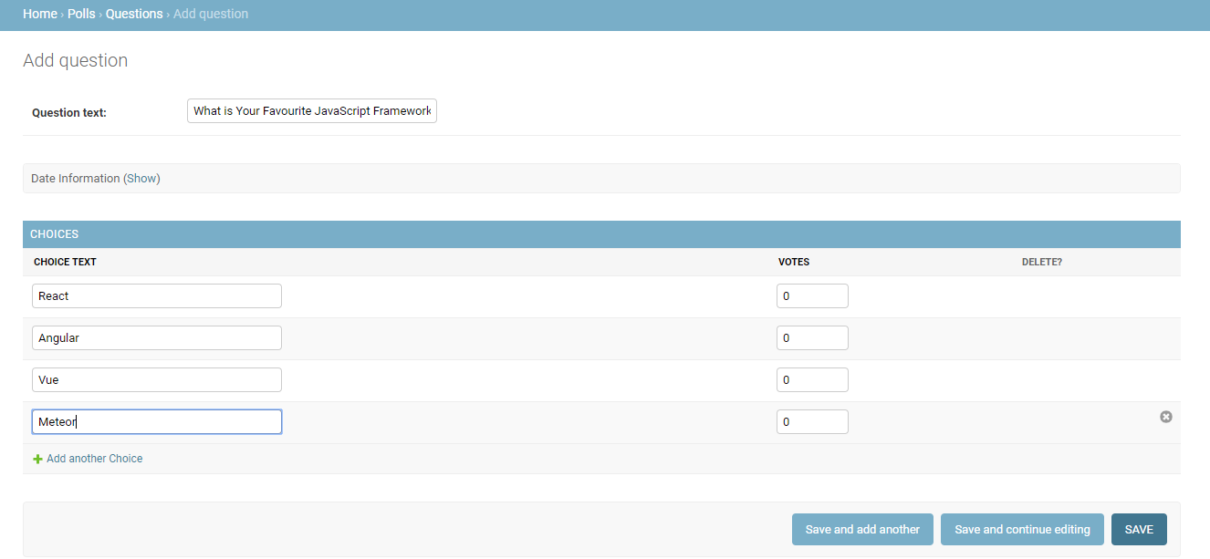
Step-2: Click on ‘add’ button next to the ‘Questions’.
Step-3: Now add question and choices for those questions. Also, mention the date and time and then click on the ‘save’ button. You can add as many questions as you want. You will see a list of questions added in the database.

Slide 29
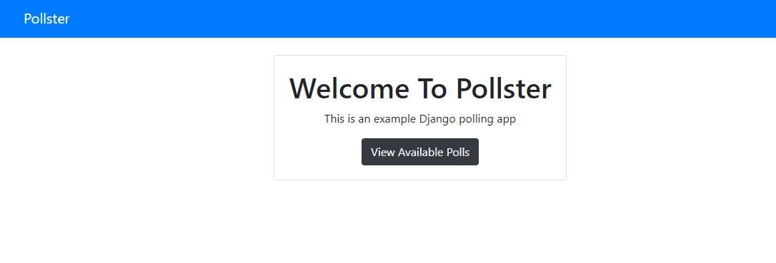
User Frontend
Step-1:
Browse the URL http://127.0.0.1:8000/ and you will see the landing page of the application. Click on the “View Available Polls”

Slide 30
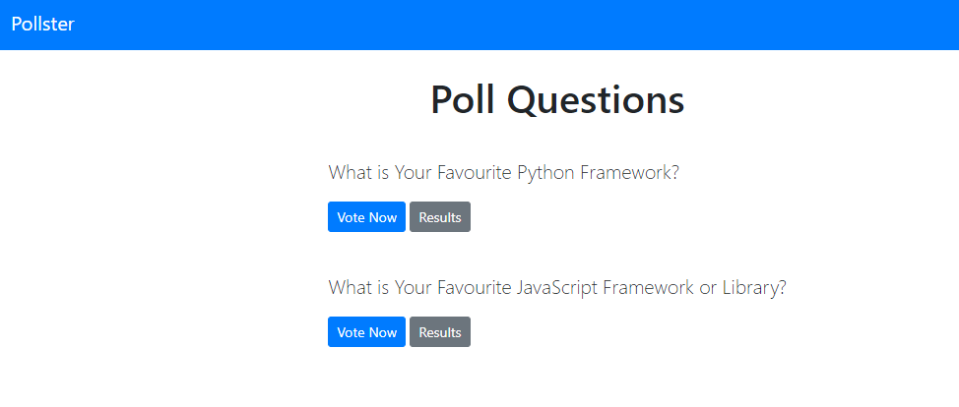
Step-2:
You will see list of questions with two options ‘Vote Now’ and ‘Results’. From here you need to select one question and click on the ‘Vote Now’ button.

Slide 31
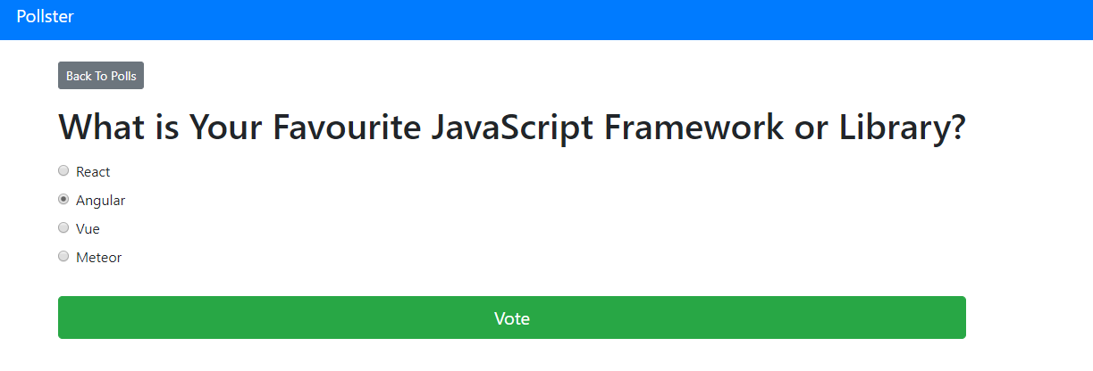
Step-3:
Once this is done select any one choice and click on ‘Vote’ button. You can also go to the previous menu using the ‘Back to Polls’ button on the top.

Slide 32
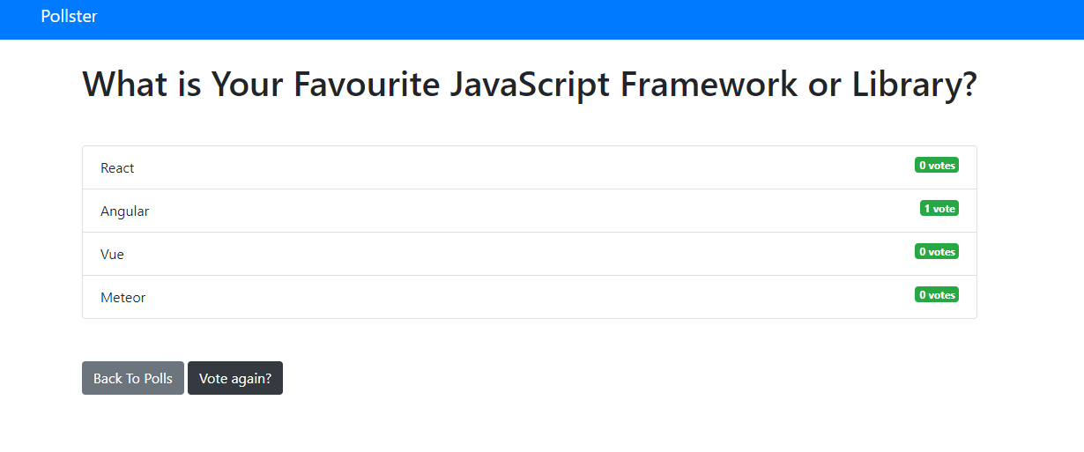
You will see the total voting result for the question you have selected.
You can also check the total votes for any question using the option ‘Results’ from the ‘Poll Questions’ page.
Future Scope:
This project can be used to conduct the online voting system in any field or industry. The project can be expanded and several other features can also be included based on the requirement. People can share the opinion and they can also check the total voting given by many users.

Slide 33
Conclusion:
In conclusion, the development of the pollster web application using Django represents a significant step towards creating an interactive and efficient platform for conducting polls. By allowing users to engage in voting on a series of questions with multiple choices, the application promotes active participation and democratic expression. The transparent calculation and display of total votes provide users with valuable insights into the collective opinions and preferences of the audience. Moreover, the inclusion of an administrative panel empowers administrators to manage the content of the application effectively, ensuring the seamless addition and management of questions. Overall, the pollster web application serves as a versatile tool for both users and administrators, facilitating the exchange of ideas and opinions in an accessible and user-friendly manner.

